Slide 1
COURSE CODE COURSE TITLE L T P J C
CSI3007 Advanced Python Programming 2 0 4 0 4
Module 6

Slide 2
Module 6: Data Handling Techniques
Objective: To perform advanced Data Preprocessing tasks like Data Merging and Munging (wrangling)
Outcome: Get an insight into Metrics Analysis

Slide 3
Module 6: Data Handling Techniques
6.1 Data wrangling
6.2 Merging and joining
6.3 Loan Prediction Problem
6.4. Data Munging using Pandas

Slide 4
Data Handling Techniques
Data handling refers to cleaning, transforming, and preparing data for analysis or modeling.
In real-world datasets (especially in finance, healthcare, and e-commerce), data often contains missing values, duplicates, inconsistent formats, or multiple sources
So before using it in machine learning or reporting, we must “wrangle” it into a usable form.

Slide 5
Data Wrangling (Data Cleaning & Preprocessing)
Data Wrangling (also called as Data Munging): process of transforming raw data into a structured and useful format for analysis - includes loading, cleaning, transforming, and enriching data
Data wrangling is the process of transforming and mapping data from one raw format into another, more appropriate and valuable format for downstream uses like analysis, reporting, or machine learning.
10/16/2026

Slide 6
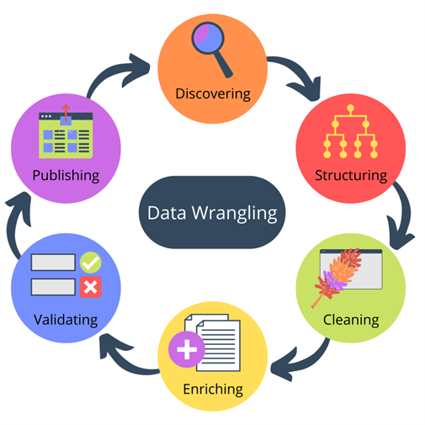
Data Wrangling (Data Cleaning & Preprocessing)
It's essentially the preparation stage where you take messy, incomplete, or complex raw data and make it clean, structured, and organized, ensuring its quality and reliability for effective decision-making.
Data wrangling is a crucial step in the data analysis process, often consuming a significant amount of a data scientist's or analyst's time.
10/16/2026

Slide 7
Key Steps in Data Wrangling
1. Discovery (or Exploration):
  Familiarizing yourself with the raw data, its sources, and its structure.
  Identifying initial patterns, inconsistencies, outliers, and missing values.
2. Structuring and Transformation:
  Reshaping the data to fit the requirements of the analytical model (e.g., converting wide data tables to long ones or vice-versa).
  Parsing data by separating it into distinct fields (e.g., splitting a full address column into street, city, and zip code).
  Joining/Merging data from multiple, disparate sources into a single, cohesive dataset.
10/16/2026

Slide 8
Key Steps in Data Wrangling
3. Cleaning:
  Handling missing values (e.g., deleting records, or imputing them with a mean, median, or other calculated value).
  Removing or correcting inconsistent data (e.g., standardizing date formats, correcting misspellings like "U.S.A.", "United States" to a single format).
  Removing duplicate records and filtering out outliers that could skew analysis.
4. Enriching:
  Adding new, derived information from existing fields (e.g., calculating a customer's age from their birth date).
  Incorporating external data sources to add more context.
5. Validation:
  Verifying the data's consistency and quality using repetitive checks or rules to ensure all changes made are accurate.
6. Publishing:
  Storing or exporting the final, clean, and structured dataset in a format ready for analysis, visualization, or machine learning models.
10/16/2026

Slide 9
Why Data Wrangling is Important?
Improved Data Quality: It ensures the data is accurate, consistent, and reliable, leading to more trustworthy results.
Effective Analysis: It transforms raw data into a format that is easily consumable by analytical tools and models, streamlining the analysis process.
Better Decisions: By basing analysis on high-quality data, businesses can make more informed and strategic decisions.
Data Integration: It allows for the seamless combination and comparison of data from various sources with different formats.
10/16/2026

Slide 10
Data Wrangling - Sample Programs
Refer the programs given for grouping and merging
Program for Data exploration and Concatenating Data
    import pandas as pd
    one = pd.DataFrame({
    'Name': ['Alex', 'Amy', 'Allen', 'Alice', 'Ayoung'],
    'subject_id':['sub1','sub2','sub4','sub6','sub5'],
    'Marks_scored':[98,90,87,69,78]},
    index=[1,2,3,4,5])
    two = pd.DataFrame({
    'Name': ['Billy', 'Brian', 'Bran', 'Bryce', 'Betty'],
    'subject_id':['sub2','sub4','sub3','sub6','sub5'],
    'Marks_scored':[89,80,79,97,88]},
    index=[1,2,3,4,5])
    print pd.concat([one,two])
10/16/2026

Slide 11
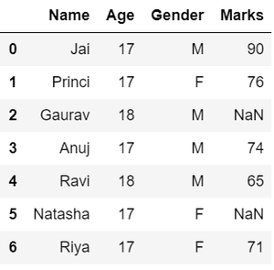
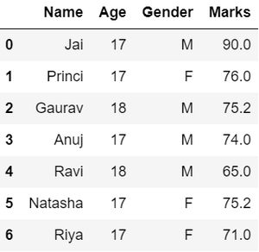
Data Wrangling - Dealing with missing values
import pandas as pd
# Assign data
data = {'Name': ['Jai', 'Princi', 'Gaurav',
'Anuj', 'Ravi', 'Natasha', 'Riya'],
'Age': [17, 17, 18, 17, 18, 17, 17],
'Gender': ['M', 'F', 'M', 'M', 'M', 'F', 'F'],
'Marks': [90, 76, 'NaN', 74, 65, 'NaN', 71]}
# Convert into DataFrame
df = pd.DataFrame(data)
# Compute average
c = avg = 0
for ele in df['Marks']:
if str(ele).isnumeric():
c += 1
avg += ele
avg /= c
# Replace missing values
df = df.replace(to_replace="NaN", value=avg)
# Display data
df
10/16/2026

Slide 12
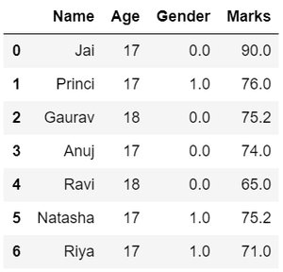
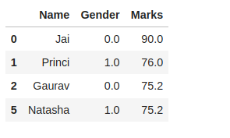
Data Wrangling - Replacing Data and Filtering data
# Categorize gender
df['Gender'] = df['Gender'].map({'M': 0, 'F': 1, }).astype(float)
# Display data
df
# Filter top scoring students
df = df[df['Marks'] >= 75].copy()
# Remove age column from filtered DataFrame
df.drop('Age', axis=1, inplace=True)
# Display data
df
10/16/2026

Slide 13
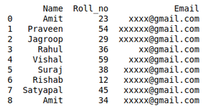
Data Wrangling - Removing Duplicate data
import pandas as pd
# initializing Data
student_data = {'Name': ['Amit', 'Praveen', 'Jagroop',
'Rahul', 'Vishal', 'Suraj',
'Rishab', 'Satyapal', 'Amit',
'Rahul', 'Praveen', 'Amit'],
'Roll_no': [23, 54, 29, 36, 59, 38,
12, 45, 34, 36, 54, 23],
'Email': ['xxxx@gmail.com', 'xxxxxx@gmail.com',
'xxxxxx@gmail.com', 'xx@gmail.com',
'xxxx@gmail.com', 'xxxxx@gmail.com',
'xxxxx@gmail.com', 'xxxxx@gmail.com',
'xxxxx@gmail.com', 'xxxxxx@gmail.com',
'xxxxxxxxxx@gmail.com', 'xxxxxxxxxx@gmail.com']}
# creating dataframe
df = pd.DataFrame(student_data)
# Here df.duplicated() list duplicate Entries in ROllno.
# So that ~(NOT) is placed in order to get non duplicate values.
non_duplicate = df[~df.duplicated('Roll_no')]
# printing non-duplicate values
print(non_duplicate)
10/16/2026

Slide 14
Merging Dataframes
  Merging is the process of combining two or more DataFrames based on a common key or index (Pandas uses merge, while SQL uses JOIN)
  The merge() function in Pandas merges two DataFrames based on their indexes or a specified column.
  It helps in combining data from different sources into a single table for analysis.
MERGE METHOD | JOIN NAME | DESCRIPTION
left | LEFT OUTER JOIN | Use keys from left frame only
right | RIGHT OUTER JOIN | Use keys from right frame only
outer | FULL OUTER JOIN | Use union of keys from both frames
inner (default) | INNER JOIN | Use intersection of keys from both frames
10/16/2026

Slide 15
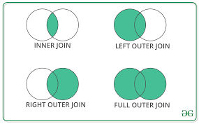
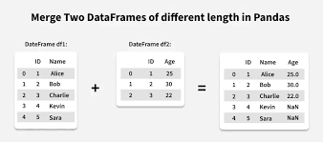
Merging Dataframes
10/16/2026

Slide 16
merge() Syntax
  pd.merge(left, right, on=None, how='inner', left_on=None, right_on=None, sort=False)
  left - specifies the left DataFrame to be merged
  right - specifies the right DataFrame to be merged
  on (optional) - specifies column(s) to join on
  how (optional) - specifies the type of join to perform
  left_on (optional) - specifies column(s) from the left DataFrame to use as key(s) for merging
  right_on (optional) - specifies column(s) from the right DataFrame to use as key(s) for merging
  sort (optional) - if True, sort the result DataFrame by the join keys
10/16/2026

Slide 17
Merging Dataframes
  # sample DataFrames with meaningful keys
  employees = pd.DataFrame({
  'employee_id': [1, 2, 3, 4],
  'name': ['Alice', 'Bob', 'Charlie', 'David']
  })
  salaries = pd.DataFrame({
  'employee_id': [2, 3, 4, 5],
  'salary': [60000, 75000, 80000, 55000]
  })
  # merge two dataframes
  merged_df = pd.merge(employees, salaries)
  print(merged_df)
Output:
employee_id name salary
0 2 Bob 60000
1 3 Charlie 75000
2 4 David 80000
10/16/2026

Slide 18
Merge DataFrames Based on Keys
  # create two DataFrames
  data1 = {
  'StudentID': [1, 2, 3, 4, 5],
  'Name': ['Alice', 'Bob', 'Charlie', 'David', 'Eve'],
  'CourseID': ['C001', 'C002', 'C001', 'C003', 'C004'],
  }
  students = pd.DataFrame(data1)
  data2 = {
  'CourseID': ['C001', 'C002', 'C003', 'C004', 'C005'],
  'CourseName': ['Math', 'English', 'History', 'Science', 'Art'],
  }
  courses = pd.DataFrame(data2)
  # merge the DataFrames based on CourseID key
  merged_data = pd.merge(students, courses, left_on='CourseID', right_on='CourseID')
  print(merged_data)
StudentID Name CourseID CourseName
0 1 Alice C001 Math
1 3 Charlie C001 Math
2 2 Bob C002 English
3 4 David C003 History
4 5 Eve C004 Science
10/16/2026

Slide 19
Left Join Pandas DataFrames
  # create two DataFrames
  data1 = {
  'StudentID': [1, 2, 3, 4, 5],
  'Name': ['Alice', 'Bob', 'Charlie', 'David', 'Eve'],
  'CourseID': ['C001', 'C002', 'C001', 'C003', 'C004'],
  }
  students = pd.DataFrame(data1)
  data2 = {
  'CourseID': ['C001', 'C002', 'C003', 'C004', 'C005'],
  'CourseName': ['Math', 'English', 'History', 'Science', 'Art'],
  }
  courses = pd.DataFrame(data2)
  # left merge dataframe
  left_join_data = pd.merge(students, courses, on='CourseID', how='left')
  print(left_join_data)
StudentID Name CourseID CourseName
0 1 Alice C001 Math
1 2 Bob C002 English
2 3 Charlie C001 Math
3 4 David C003 History
4 5 Eve C004 Science
10/16/2026

Slide 20
Right and Inner Joins of Pandas DataFrames
  right_join_data = pd.merge(students, courses, on='CourseID', how='right')
StudentID Name CourseID CourseName
0 S001 Alice C001 Math
1 S003 Charlie C001 Math
2 S002 Bob C002 English
3 S004 David C003 History
4 S005 Eve C004 Science
5 NaN NaN C005 Art
inner_join_data = pd.merge(students, courses, on='CourseID', how='inner')
StudentID Name CourseID CourseName
0 1 Alice C001 Math
1 3 Charlie C001 Math
2 2 Bob C002 English
3 4 David C003 History
4 5 Eve C004 Science
10/16/2026

Slide 21
Outer and Cross Joins of Pandas DataFrames
  right_join_data = pd.merge(students, courses, on='CourseID', how=‘outer')
StudentID Name CourseID CourseName
0 S001 Alice C001 Math
1 S003 Charlie C001 Math
2 S002 Bob C002 English
3 S004 David C003 History
4 S005 Eve C004 Science
5 NaN NaN C005 Art
StudentID Name CourseID_x CourseID_y CourseName
0 1 Alice C001 C001 Math
1 1 Alice C001 C002 English
2 1 Alice C001 C003 History
3 1 Alice C001 C004 Science
4 1 Alice C001 C005 Art
5 2 Bob C002 C001 Math
6 2 Bob C002 C002 English
7 2 Bob C002 C003 History
8 2 Bob C002 C004 Science
9 2 Bob C002 C005 Art
10 3 Charlie C001 C001 Math
11 3 Charlie C001 C002 English
12 3 Charlie C001 C003 History
13 3 Charlie C001 C004 Science
14 3 Charlie C001 C005 Art
15 4 David C003 C001 Math
16 4 David C003 C002 English
17 4 David C003 C003 History
18 4 David C003 C004 Science
19 4 David C003 C005 Art
20 5 Eve C004 C001 Math
21 5 Eve C004 C002 English
22 5 Eve C004 C003 History
23 5 Eve C004 C004 Science
24 5 Eve C004 C005 Art
cross_join_data = pd.merge(students, courses, on='CourseID', how=‘cross')
10/16/2026

Slide 22
Joining Dataframes
DataFrame.join() is another way to combine DataFrames, but it joins based on the index (row labels) or a key column.
It is a simpler version of merging, often used when both DataFrames have the same index.
df1.join(df2, how='type_of_join')
10/16/2026

Slide 23
Loan Prediction Problem
Popular machine learning case study used to understand data preprocessing, feature handling, and classification.
It is a supervised machine learning problem in which the task is to predict whether a loan should be approved or not based on the applicant’s details.
Banks receive numerous loan applications daily - Manually evaluating each application is time-consuming and subjective - machine learning models can be used to automate the process of loan approval by analyzing patterns from the applicant’s historical data
10/16/2026

Slide 24
Loan Prediction Problem
A bank wants to automate the process of loan approval.
Based on details like applicant income, loan amount, education, employment status, credit history, etc., the bank wants to predict whether a loan application should be approved (Y) or rejected (N).
Type of Problem
  Category: Supervised Learning
  Type: Classification Problem (Binary Classification – Yes/No)
  Goal: Build a model that classifies applicants into “Approved” or “Not Approved.”
10/16/2026

Slide 25
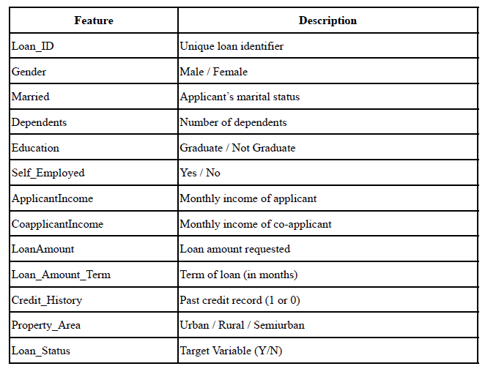
Loan Prediction Problem
Dataset Description
  The dataset usually contains both numerical and categorical features.
  A typical dataset (loan.csv) may look like this:
10/16/2026

Slide 26
Loan Prediction Problem
Step 1: Problem Understanding
Define the goal clearly — predicting loan approval based on customer information.
Identify the target variable (Loan_Status) and input features.
Step 2: Data Collection
Collect data from a CSV or dataset repository (e.g., Kaggle).
Load data into Python using Pandas
    import pandas as pd
    df = pd.read_csv("loan_data.csv")
10/16/2026

Slide 27
Loan Prediction Problem
Step 3: Data Exploration (EDA – Exploratory Data Analysis)
Understand the data using:
      df.head()
      df.info()
      df.describe()
      df.isnull().sum()
Purpose:
  Identify missing values.
  Check data types.
  Observe relationships between variables.
Example insights:
  Higher income applicants usually get loans approved.
  Applicants with good credit history have higher chances of approval.
10/16/2026

Slide 28
Loan Prediction Problem
Step 4: Data Cleaning and Preprocessing
Clean and prepare the data for analysis.
Handle Missing Values
  df['Gender'].fillna(df['Gender'].mode()[0], inplace=True)
  df['LoanAmount'].fillna(df['LoanAmount'].mean(), inplace=True)
Encoding Categorical Data
  Convert text data (Male/Female, Yes/No) into numbers:
  df['Gender'] = df['Gender'].map({'Male':1, 'Female':0})
  df['Married'] = df['Married'].map({'Yes':1, 'No':0})
10/16/2026

Slide 29
Loan Prediction Problem
Step 5. Feature Engineering
  Create new meaningful features:
  df['TotalIncome'] = df['ApplicantIncome'] + df['CoapplicantIncome']
Step 6. Remove Unnecessary Columns
  df.drop('Loan_ID', axis=1, inplace=True)
10/16/2026

Slide 30
Loan Prediction Problem
Step 7: Splitting Data into Train and Test Sets
  Training set (80%) → to train the model
  Testing set (20%) → to evaluate model performance
from sklearn.model_selection import train_test_split
X = df.drop('Loan_Status', axis=1)
y = df['Loan_Status'].map({'Y':1, 'N':0})
X_train, X_test, y_train, y_test = train_test_split(X, y, test_size=0.2, random_state=42)
10/16/2026

Slide 31
Loan Prediction Problem
Step 8: Model Building - Try different algorithms to find the best one.
Common Models:
  Logistic Regression – best for binary classification
  Decision Tree
  Random Forest
  K-Nearest Neighbors (KNN)
  Support Vector Machine (SVM)
Example using Logistic Regression:
  from sklearn.linear_model import LogisticRegression
  model = LogisticRegression()
  model.fit(X_train, y_train)
10/16/2026

Slide 32
Loan Prediction Problem
Step 9: Model Evaluation
Evaluate the performance of the model using metrics like:
  Accuracy
  Confusion Matrix
  Precision, Recall, F1-score
  from sklearn.metrics import accuracy_score, confusion_matrix, classification_report
  y_pred = model.predict(X_test)
  print("Accuracy:", accuracy_score(y_test, y_pred))
  print(confusion_matrix(y_test, y_pred))
  print(classification_report(y_test, y_pred))
10/16/2026

Slide 33
Data munging using Pandas
Data Mugging refers to the process of cleaning, transforming, and
preparing raw data to make it suitable for analysis or machine learning models.
It’s an informal term for data preprocessing or data wrangling.
10/16/2026

Slide 34
Data munging using Pandas
Understanding the Data
  .info(), .describe(), .head(), .shape
  Identify missing values and data types.
Data Cleaning
  Handle missing values: .fillna(), .dropna()
  Convert categorical data: .map(), .replace()
  Correct data types: .astype()
Data Transformation
  Creating new columns: derived metrics (e.g., total income)
  Example: df['TotalIncome'] = df['ApplicantIncome'] + df['CoapplicantIncome']
10/16/2026

Slide 35
Data munging using Pandas
Data Filtering and Selection
  Use conditions and boolean indexing: df[df['LoanAmount'] > 200]
Data Grouping and Aggregation
  Summarizing data using .groupby() and .agg()
  Example: df.groupby('Education')['Loan_Status'].value_counts()
Merging and Joining
  Combining datasets using merge(), concat(), join()
  Example: merged_df = pd.merge(df1, df2, on='Loan_ID', how='inner')
Encoding and Feature Engineering
  Convert categorical variables into numeric (using pd.get_dummies())
10/16/2026

Slide 36

Summary of the session….
Data wrangling, merging and joining
Loan Prediction Problem
Data munging using Pandas

